Slide 1

FEBRUARY 4TH 2021
VIRTUAL WORKSHOP
VIRTUAL WORKSHOP ON THE
CITY OF GARDENA HOUSING ELEMENT 2021-2029

Slide 2
Housing Element Team
City Staff:
Ray Barragan, Acting Community Development Director
Amanda Acuna, Senior Planner
Brian Ramirez, Intern
Lisa Kranitz, Assistant City Attorney
Consultants:
Veronica Tam, Veronica Tam & Associates, Housing Consultant
Starla Barker, De Novo Planning Group, Environmental Consultant
Amanda Tropiano, De Novo Planning Group, Environmental Consultant
Notes:
[Raymond]

Slide 3
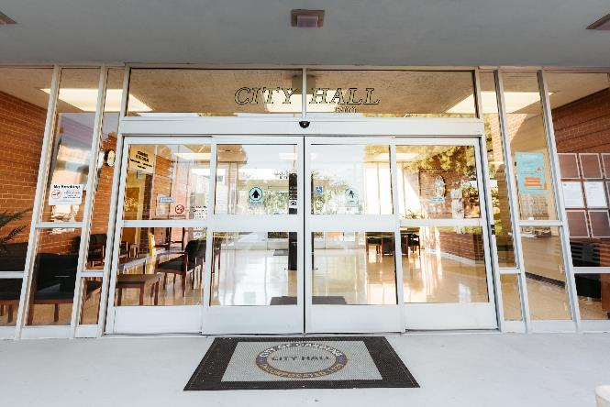
Agenda
What is a Housing Element?
The Regional Housing Needs Allocation
What laws play into the Housing Element?
Sites Inventory
Policy Considerations
Next Steps
Notes:
[Raymond]

Slide 4
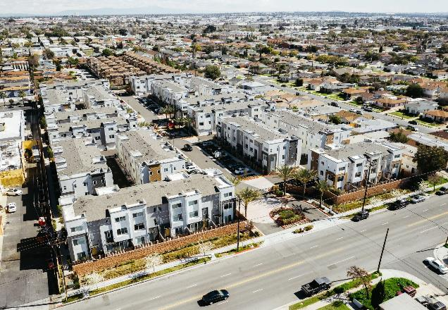
What is a Housing Element?
The Housing Element is one of the required elements of the General Plan
It is reviewed and certified by the California Department of Housing and Community Development (HCD) for compliance with State law
It covers an 8-year period of October 2021 – October 2029
Housing Element Content:
Analysis of existing and projected housing needs
Inventory of available sites for housing
Analysis of potential constraints on housing
Fair housing analysis
Evaluation of previous housing element
Goals, policies, and implementation programs
Notes:
[Raymond/Veronica]

Slide 5
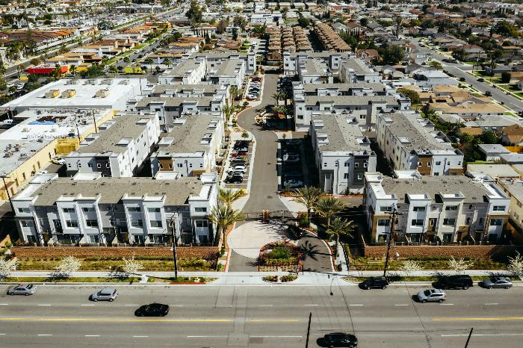
The Regional Housing Needs Allocation (RHNA)
The RHNA is a requirement of State law
Statewide projected and existing housing need is first determined by HCD and then split up by regions. The Regional Housing Need for the six county Southern California Association of Governments (SCAG) region was approximately 1,341,827
SCAG then assigns the housing needs to each local jurisdiction.
The RHNA numbers inform the City of how the needed housing in 4 different income categories – Very Low; Low; Moderate; and Above Moderate
Notes:
[Veronica]

Slide 6
The Regional Housing Needs Allocation (RHNA)
Gardena’s allocation is:
Gardena’s appeal of this allocation was denied, along with almost every other jurisdiction.
RHNA allocation is NOT an obligation to build the units.
Must demonstrate adequate capacity for various income levels.
INCOME CATEGORY | ALLOCATION
Very Low | 1,481 (26%)
Low | 759 (13%)
Moderate | 892 (16%)
Above Moderate | 2,589 (45%)
TOTAL | 5,721
Notes:
[Veronica]

Slide 7
The Regional Housing Needs Allocation (RHNA)
Los Angeles County AMI=$77,300 | Household Size | 1-person | 2-person | 3-person | 4-person | 5-person
 | Extremely Low | 23,700 | 27,050 | 30,450 | 33,800 | 36,550
 | Very low | 39,450 | 45,050 | 50,700 | 56,300 | 60,850
 | Low | 63,100 | 72,100 | 81,100 | 90,100 | 97,350
 | Moderate | 64,900 | 74,200 | 83,500 | 92,750 | 100,150
Notes:
[Veronica]

Slide 8
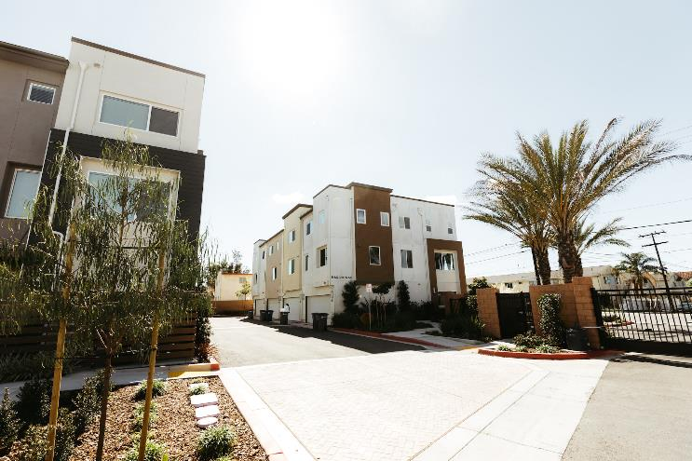
What Laws Pertain to the Housing Element and Site Selection (A Sampling)
AB 671 – ADUs
Housing Element must include a plan to incentivize and promote the creation of affordable accessory dwelling units
SB 166 – Prohibition on Reducing Density
If sites are being developed with fewer total units and/or not in the income levels assumed in the Housing Element – City either has to make finding that there are still adequate sites available as shown in the Housing Element or identify new properties to make up for loss within 180 days
SB 330 – Downzoning Prohibited – No Net Loss
City cannot enact policies, standards, conditions that change zoning and general plan designations unless other properties are changed to make up for the difference
AB 1397 – Minimum Density
In order to count site for affordable housing, it must allow at least 30 du/acre
AB 72 – Increased HCD Enforcement
HCD may revoke certification and report violations to Attorney General to enforce
Notes:
[Veronica]

Slide 9
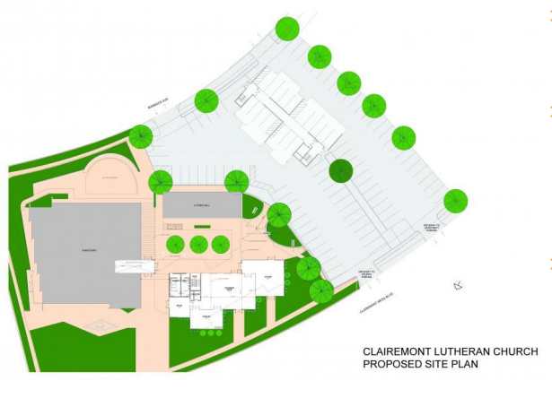
What Laws Pertain to the Housing Element and Site Selection
AB 1851 – Religious Institutions
Affordable housing projects by nonprofit developers on property owned by religious institutions – can eliminate 50% of required parking for the religious use allowing housing to be built on the parking lot sites
Example – San Diego 12 low-income homes on existing parking lot
Notes:
[Veronica]

Slide 10
Breakdown of Allocation
DENSITY REQUIREMENT
INCOME CATEGORY | ALLOCATION
Very Low + Low | 2,240 + 20% = 2,688
Moderate + Above Moderate | 3,481
TOTAL | 6,169 units
Must be ≥ 30du/ac
≥ 0.5 acre site
Can be < 30 du/ac
Notes:
20% = 448
The City must identify sufficient sites in its Housing Element to accommodate the assigned housing at each income level.
Best Practices – provide a 10 – 20% buffer (lower income units) to account for SB 166.
To provide an adequate buffer City needs to find room to place 2,688 lower income units in City on property that allows at least 30 du/acre and parcel size is at least 0.5 acre.
ADUs can account for approximately 140 units.
Moderate and above moderate housing can be placed on sites that are zoned for less than 30 du/acre.
Allocation of 3,481 for moderate and above moderate can be reduced by projects in the pipeline – provided building permits are obtained after July 1, 2021:

Slide 11
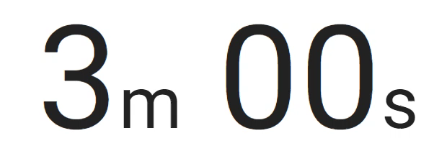
Questions?

Slide 12
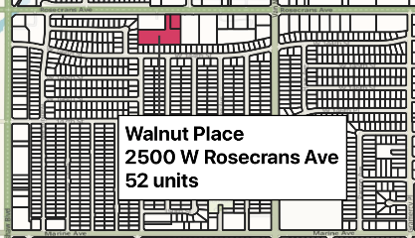
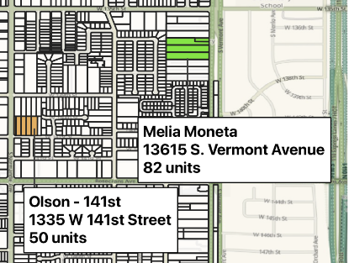
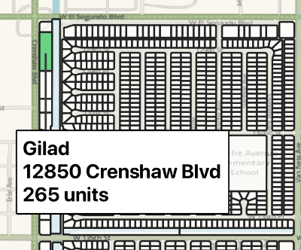
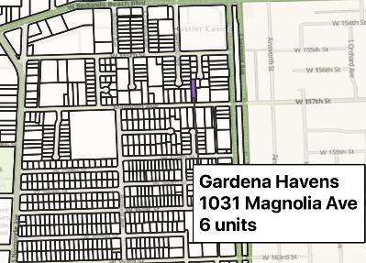
Sites Inventory - Approved and Pending Development
PROJECT | UNITS
Approved Projects
Melia Moneta | 84 (2 affordable)
Olson - 141st | 50
G3 – Walnut Place | 52
Total Approved | 186
Pending Projects - General Plan/ Zoning Change Required
Gardena Transit Oriented Development Specific Plan | 265 units
Gardena Havens | 6 units
Total Pending | 271 units
TOTAL: 457 units

Slide 13
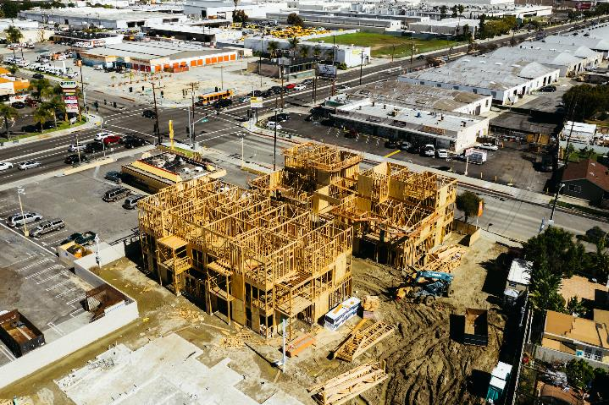
Sites Inventory - Selecting Sites for Housing Development
City has to justify site selection; generally, need to look at sites between 0.5 and 10 acres
Gardena has very little vacant land – approximately 5 acres total
Only sites which have potential for near-term development qualify for identifying sufficient sites
Staff went through and identified properties that could likely be redeveloped based on condition of property, age of buildings, use, or expressed interest
The only way to meet the statutory obligation will probably be to do a housing overlay on commercial and industrial properties
State law prohibits the concentration of affordable housing in one location; it must be spread throughout City

Slide 14
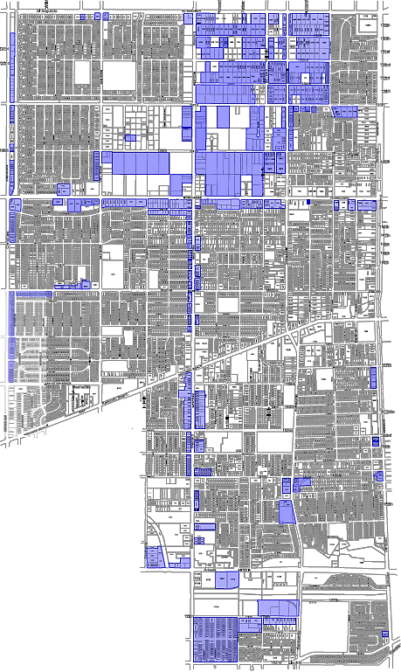
Sites Inventory - Selecting Sites for Housing Development

Slide 15
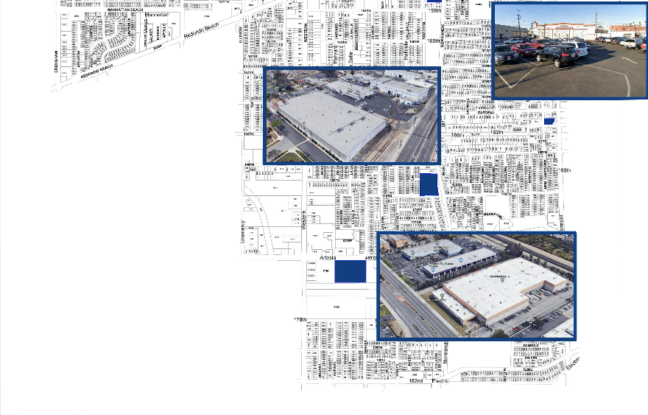
Sites Inventory - Expressed interest in residential development
LOCATION: 16911 S. Normandie
SIZE: 3.9 acres
POTENTIAL UNITS: 250
COMMENT: GPA/ZC/SP
LOCATION | SIZE | POTENTIAL UNITS | COMMENT
16911 S. Normandie | 3.9 acres | 250 | GPA/ZC/SP
1610/1650 Artesia | 7.6 acres | 494 | GPA/ZC/SP
1012 Gardena Blvd./Parking area | 1.0 acre | 24 | Allowed by right
TOTAL |  | 768
LOCATION: 1012 Gardena Blvd./Parking area
SIZE: 1.0 acres
POTENTIAL UNITS: 24
COMMENT: Allowed by-right
LOCATION: 1610-1650 Artesia
SIZE: 7.6 acres
POTENTIAL UNITS: 494
COMMENT: GPA/ZC/SP

Slide 16
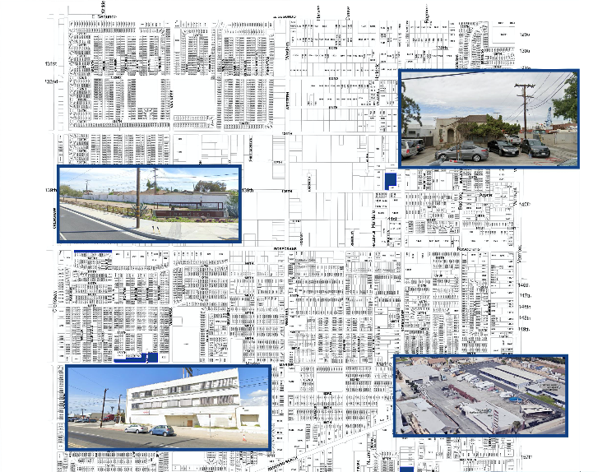
Sites Inventory - Expressed interest in residential development
LOCATION: 1433 W 139th St.
SIZE: 1.88 acres
POTENTIAL UNITS: 45
COMMENT: GPA/ZC to R-4
LOCATION | SIZE | POTENTIAL UNITS | COMMENT
2315 – 2545 Marine | 2.9 acres | 64 | Allowed by right
15717/15725 S. Normandie | .91 acre | 30 | Allowed by right
1433 W. 139th Street | 1.88 acres | 45 | GPA/ZC to R-4
2800 Rosecrans | .99 acres | 20 | GPA/ZC
TOTAL |  | 159
LOCATION: 2800 Rosecrans
SIZE: .99 acres
POTENTIAL UNITS: 20
COMMENT: GPA/ZC
LOCATION: 2315-2545 Marine
SIZE: 2.9 acres
POTENTIAL UNITS: 64
COMMENT: Allowed by-right
LOCATION: 15717-15725 S. Normandie
SIZE: .91 acres
POTENTIAL UNITS: 30
COMMENT: Allowed by-right
TOTAL: 927 units

Slide 17
RHNA Strategy
LOCATION | POTENTIAL ADDITIONAL UNITS | COMMENT
Recycled Residential (R3/R4/MUO) | 448 units | Moderate + Above Moderate
Project in the pipeline | 455 units 2 affordable units | Moderate + Above Moderate Very Low + Low
ADUs Expressed Interest | 140 units 927 units | Moderate + Above Moderate Very Low + Low Moderate + Above Moderate
TOTAL | 1,972 units
Still need to accommodate: 4,197 units
(including buffer)
Notes:
Still working on this slide

Slide 18
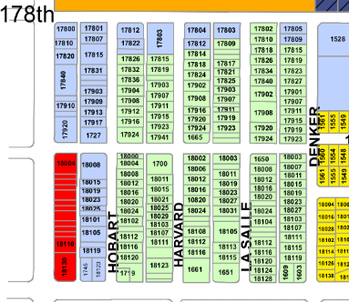
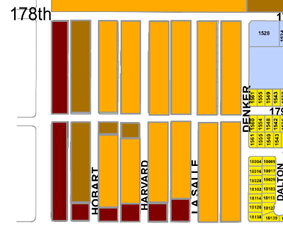
Sites Inventory – Rezoning/Upzoning to Residential
LOCATION | SIZE | POTENTIAL UNITS | COMMENT
H-B Properties (Net) | 22.3 acres | 257 | Increase allowed zoning to match R-3

Slide 19
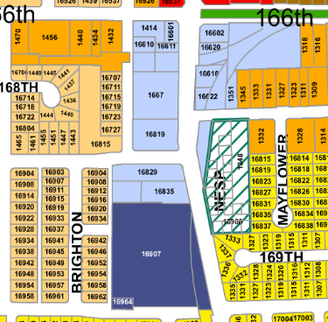
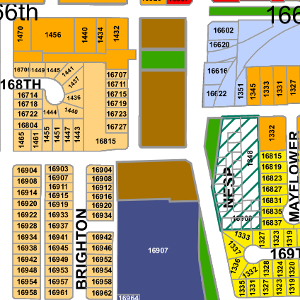
Sites Inventory – Rezoning/Upzoning to Residential
LOCATION | SIZE | POTENTIAL UNITS | COMMENT
M-1 Properties south of 166th | 3 acres | 69 | Rezone M-1 to R-4

Slide 20
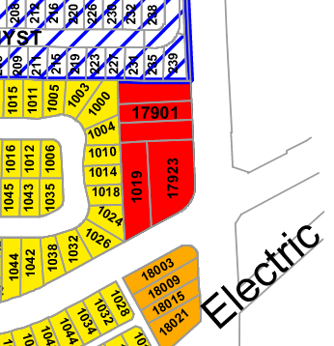
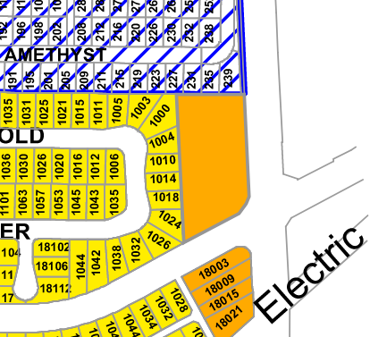
Sites Inventory – Rezoning/Upzoning to Residential
LOCATION | SIZE | POTENTIAL UNITS | COMMENT
17901 Vermont (and properties on either side) | 1.58 acres | 27 | Rezone C-3 to R-3

Slide 21
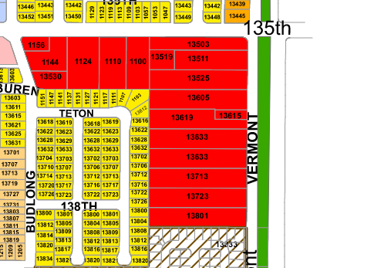
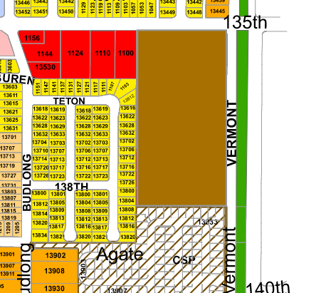
Sites Inventory – Rezoning/Upzoning to Residential
LOCATION | SIZE | POTENTIAL UNITS | COMMENT
Properties around 135th and Vermont | 1.38 acres | 32 | Rezone from C-3 to R-4 – required stepped density away from R-1
TOTAL: 33.76 acres 408 units

Slide 22
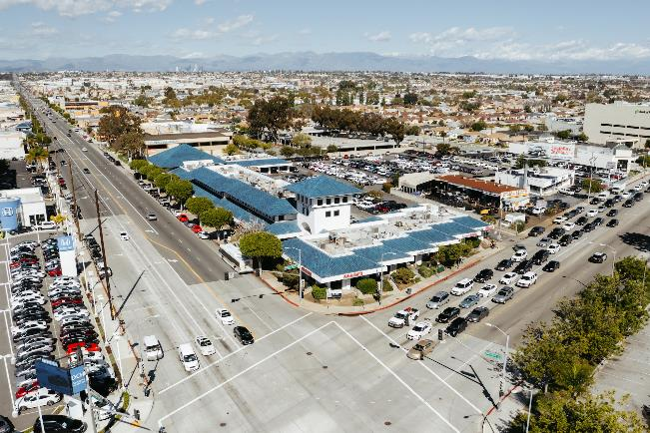
Policy Considerations/Changes
If City allows higher density on major arterials, could protect more property from having overlay
Should City enact an inclusionary affordable housing component to development projects?
Change zoning provisions: R-3 zone
Do not allow single family/duplex
40% of R-3 zone exceeds 17 du/acre –increase maximum density – at least in some locations

Slide 23
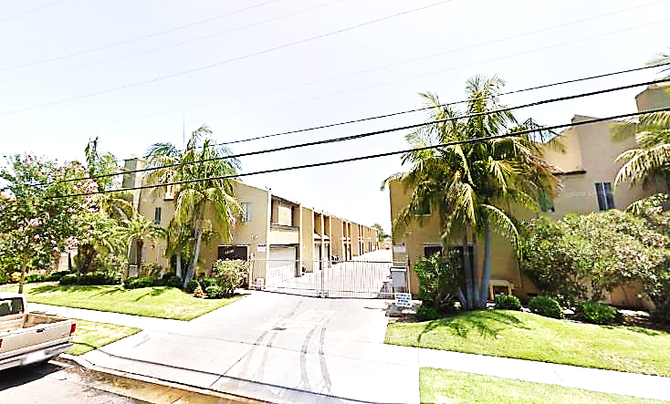
Policy Considerations/Changes
Change zoning provisions: R-4 zone
Anything over 0.5 acres should be 30 du/acre
Eliminates mid-step of 27 du/acre for properties 0.5 – 1.0 acre
61% of R-4 zone exceeds 30 du/acre – increase maximum density – at least in some locations
Increase minimum required density
Change zoning provisions: MUO zone
Anything over 0.5 acres should be 30 du/acre
Eliminates mid-step of 25 du/acre for properties 0.5 - .99 acre
Increase minimum required density

Slide 24
Next Steps
February – March 2021 | Additional community input on proposed rezone strategy for meeting the RHNA (Actual rezoning can occur within 3 years from October 2021)
May 2021 | Draft Housing Element for public input
May – August 2021 | CEQA for Housing Element
June – August 2021 | Public Review Draft Housing Element for HCD review
September – October 2021 | Adoption hearings
Notes:
[Veronica]

Slide 25
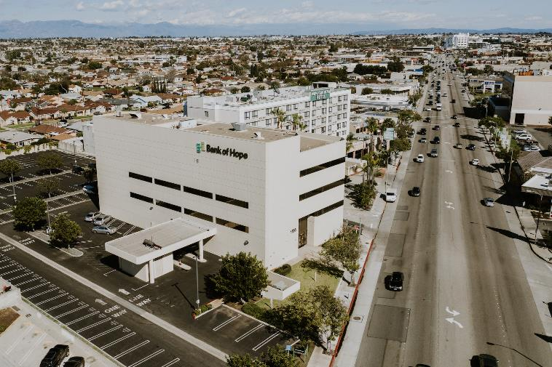
What if Gardena does not comply?
Ineligibility/reduced preference for grants
Lawsuit by Attorney General’s Office
Penalties of between $10,000 - $100,000 per month
Court can prohibit issuance of permits for any development
Court can appoint a receiver to take over

Slide 26
Questions?

Slide 27
Future Notification
Email: aacuna@cityofgardena.org
Call: 310-217-9524
Website: https://www.cityofgardena.org/housing-element/

Slide 28
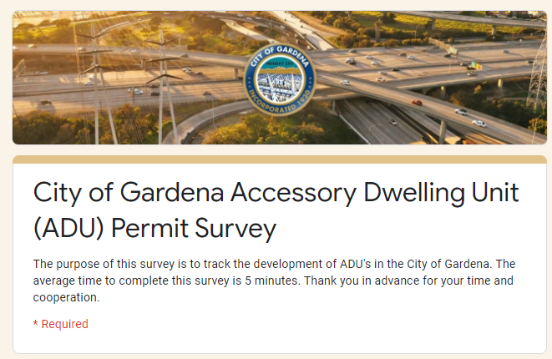
Accessory Dwelling Unit Survey
https://www.cityofgardena.org/housing-element/

Slide 29
Thank you for attending!

